Slide 1

INTRODUCTION
US Superstore has been very successful, with sales increasing rapidly. Management desires to begin selling its products globally within the next five years.
US Superstore’s files from 2011 onward are currently maintained in Excel worksheets. Three worksheets are available: order to cash, returns, and personnel. The company provides customers with three main categories of products: office furniture, office supplies, and technology.
Customers are grouped into Consumers, Corporate, and Home Office. The geographical regions are Central, East, West, and South. Customer sales data are available for the years 2011 through 2014.

Slide 2
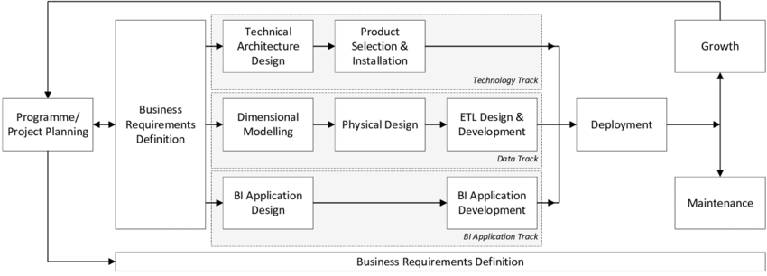
Business Lifecycle Approach

Slide 3
Business Process
Business Process/Event | Date & Time | Vendor | Product | Part | Transaction | Customer | Media | Service policy | Status & Types | Carrier
Procurement | X | X | X | X | X |  |  |  | X | X
Manufacturing | X | X | X | X |  |  |  |  |  | X
Sales | X | X | X |  | X | X |  | X | X
Inventory | X |  | X |  |  |  |  | X | X | X
HR | X |  |  |  |  | X | X | X | X
Financial | X |  | X |  | X |  |  |  | X
Payroll | X |  |  |  |  |  |  | X
Marketing | X |  |  |  |  |  | X
Customer services |  |  |  |  |  | X |  | X
Infrastructure and Operations | X | X | X |  | X | X | X |  | X | X

Slide 4
Opportunity Matrix
Organization/Work Groups
 | Customer Services | Financial | Operations | Human Resource | Logistics | Strategy management
Online sales transaction | X | X | X | X | X | X
In-store sales transaction | X | X | X | X |  | X
Vendor sales transaction |  | X |  |  | X
Order processing |  |  | X
Delivery process |  |  | X
Return policy | X | X |  |  | X
Business Process

Slide 5
High-Level Bus Matrix
 | Date | Material | Location | Owner | Product | Service policy | Account status | Order | Customer
Online sales transaction | X | X |  |  | X | X | X | X | X
Order processing | X |  | X | X | X | X | X | X | X
Delivery process | X |  | X | X |  | X | X | X | X
Return policy | X |  | X |  |  | X | X | X | X

Slide 6
Detailed Bus Matrix
E-commerce Business Process | Fact tables | Granularity | Fact | Date | Product | Location | Owner | Service policy | Account status
Online Sales Transaction | sales transaction | Per line item | purchase date key purchase amount key purchase unit price key transaction number | x | x |  | x | x | x
 | click stream | Per click | referral key session key time key event key page key | x | x |  |  | x | x
 | Vendor information | Per vendor item | vender number key vendor product amount key | x | x | x | x | x
Order Processing | warehouse picking | Per warehouse receipt | ship date key requested date key product key vendor key | x | x |  | x | x
 | billing and invoicing | Per order | date key order number quantity key product key | x | x |  | x |  | x
Delivery Process | shipping notice | Per line item | shipping date key shipping cost key tracking number delivery company key | x | x | x | x | x | x
 | delivery operation | Per line item | tracking number shipping date delivery cost key | x | x | x |  | x | x
Return Policy | store return process | Per line item | store number key item number key return date key | x | x | x |  | x | x
 | mail return process | Per line item | tracking number return date key | x | x |  | x | x | x

Slide 7

Prioritization Grid
High
BP1
BP2
BP3
BP5
Potential
Business Impact
BP6
BP4
Low
Low
High
Feasibility
Business process - BP

Slide 8
Steps to Dimensional Modeling
1 | Choose a Business Process and its data | A Business Process is chosen as a Fact Table Design the DW by the Business Process not the Business Unit Unilever – Recruitment and Selection
2 | Choose the Grain of the Business Process | Represents one row of the Fact Table Choose the lowest possible grain, aggregate to higher levels Unilever – Each new hire role_location in fact table
3 | Choose Dimensions of the Business Process | Dimensions explain Fact tables Represent Query Entry-Points into the Star Schema Each Dimension has several Attributes Unilever – Time, employee, location in the fact table
4 | Choose the measured Facts | Facts are numeric fields that populate each fact table record Unilever – employee salary and compensation offered

Slide 9
Logical Fact Diagram
Segment
Customer
Order date
Product
Order
Sales Summary Fact
Relationship
Sales Detailed Fact
Returned
Region
Shipping

Slide 10
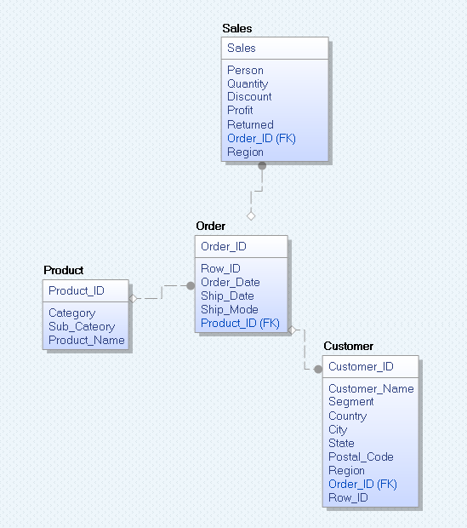
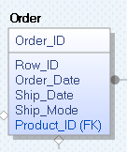
Star Schema
Detailed Fact Table
Dimensions are the key aspects related to a fact table and where the data is extracted for most of the elements of the fact tables.

Slide 11
Dimension Attribute Detailed Description: Item Dimension
Name | Description | Cardinality | Slow Changing Dimension Policy | Sample Values
Product ID | Product Number is a unique value to identify a product/item. | 9990+ | No Update | SAA-SA-00000000
Sales | The number of a product's sales | - | Type 2 | -
Profit | Profit made from the sale of an item | - | Type 2 | -
Item Category | Item category describes the type of an item. | 3 | Type 1 | Furniture, Office Supplies, Technology
Item Subcategory | Item Subcategory is to define a type of an item within the category. | 17 | Type 1 | Bookcases, Chairs, Labels, Tables, Storage etc.
Ship Mode | Mode of Shipping | 4 | Type 1 | First Class, Same Day, Second Class, Standard Class.

Slide 12
Detailed Dimension table Diagram: Item Dimension
Product ID
(9994)
Item Category
Sales
(3)
Item Subcategory
Profit
(17)
Ship Mode
(4)

Slide 13
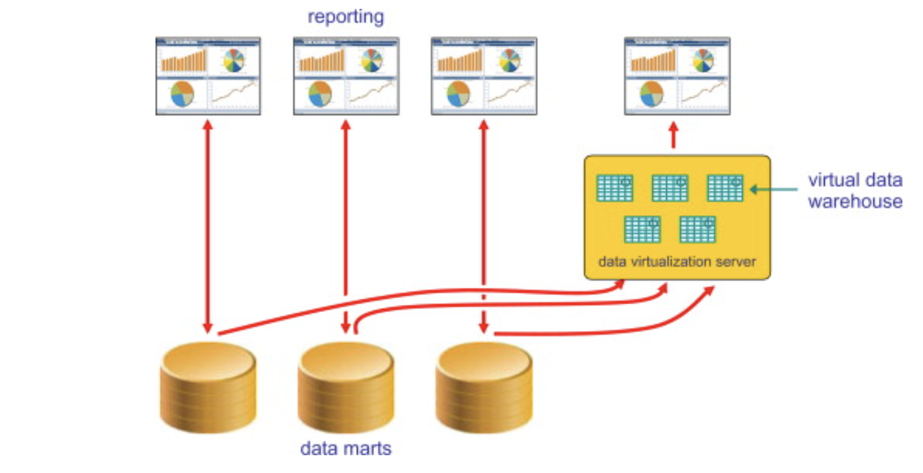
Confirmed Dimension
Dimension tables conform when attributes in separate dimension tables have the same column names and domain contents. Information from separate fact tables can be combined in a single report using conformed dimension attributes associated with each fact table.
The conformed dimensions approach tied disparate data marts into a logical “single version of the truth” without needing a Data Warehouse.
The data needs to be either instance for instance identical, or derivable one from the other as, for example, when one set of data is a summarization of the other.

Slide 14
Confirmed Dimension
Proposal Dimension by Salesperson, Product, Proposal and Proposal Date
Order Dimension by Salesperson, Customer, Product, Contract and Order Date
Shipping Dimension by Salesperson, Customer, Product, Contract, Shipment, Shipper, and Shipment Date
Return Dimension Customer, Product, Contract, Reason and Return Date.
All these dimensions have also Date and Time in common as all these tables have a record of these information to function properly to their full extent.
The below diagram actually contains 2 dimensions in common which are date and time with order date and order tables between the 2 fact tables.
Date & Time
Order date
Order

Slide 15
Transformation Rules
Rule Type | Description
Move | The Source Data and Destination data needs to be same, for example addresses of clients
Transform | The values from the source data are transformed to the values from the targeted data. That is, A will equal B. for example currency exchange for online orders worldwide
Default | f there are no values in the Source field. It will Insert the default value in the Target table in such scenarios. For ex the dates if not entered will get the order day dates.
Derive | The target value is created by applying the source field value to a rule or arithmetic computation. Adding total orders in the cart, for example, to get a new total.
Reading master data | A field from Source is always referenced to the main database to compare/calculate it to something for example the real time prices/inventory.
Lookup | To determine if the value for the source field exists, use source field to access a loaded table. For ex to see if a product exists in the database

Slide 16
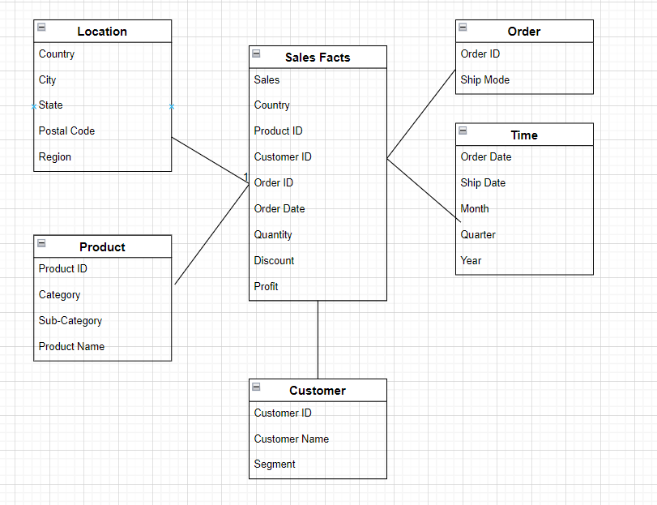
High-level Aggregate Diagram
Sales Facts
Location
Order
Customer
Product
Time
The diagram above shows a one-way aggregated data

Slide 17
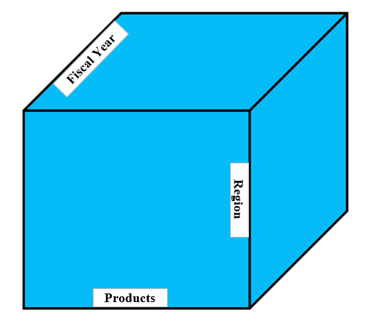

OLAP MDDB Cube
2017
2016
2015
2014
Furniture
Office Supplies
Business
Category
Technology
East
West
South
Central
Region
The dimension of Product (Furniture, Office Supplies, and Technology), Region, and Fiscal Year are all Dense Dimensions.

Slide 18
Dimension Hierarchy: Year
Year
First Quarter
Second Quarter
Third Quarter
Fourth Quarter
Months – Jan to Mar
Months – Apr to Jun
Months – Jul to Sep
Months – Oct to Dec

Slide 19
Dimension Hierarchy: Region
Region
West
South
East
Central

Slide 20

Profits Dashboard

Slide 21
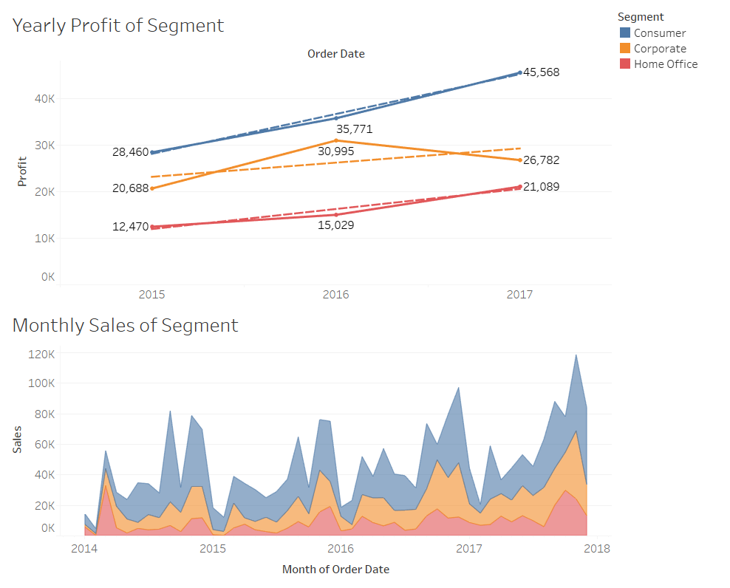
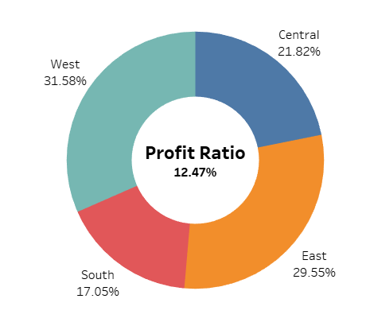
High-Level Yearly Profit

Slide 22
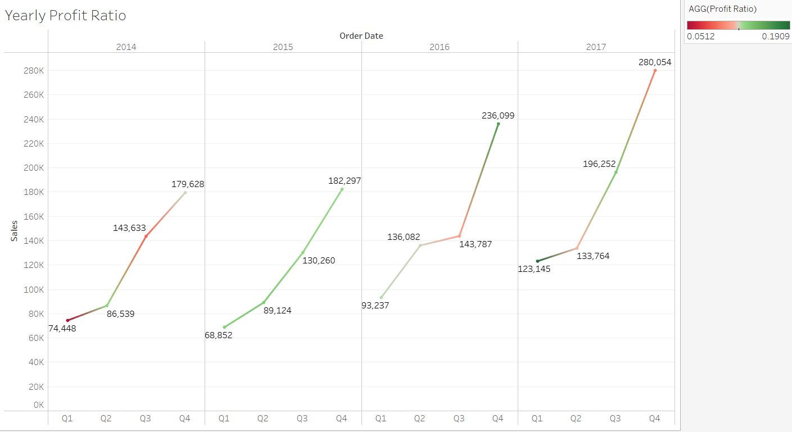
Year Profit Trend - Quarterly

Slide 23
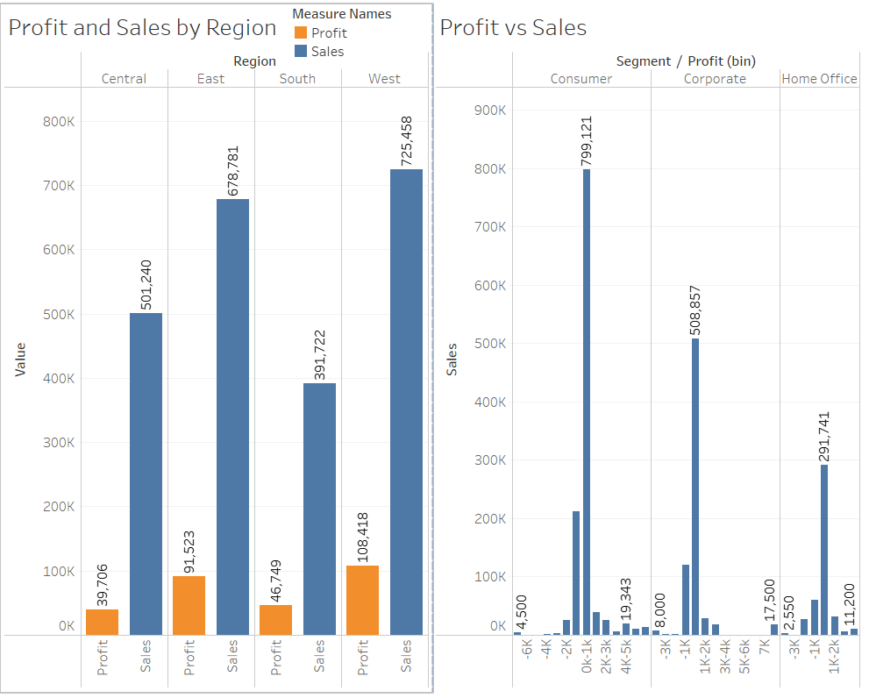
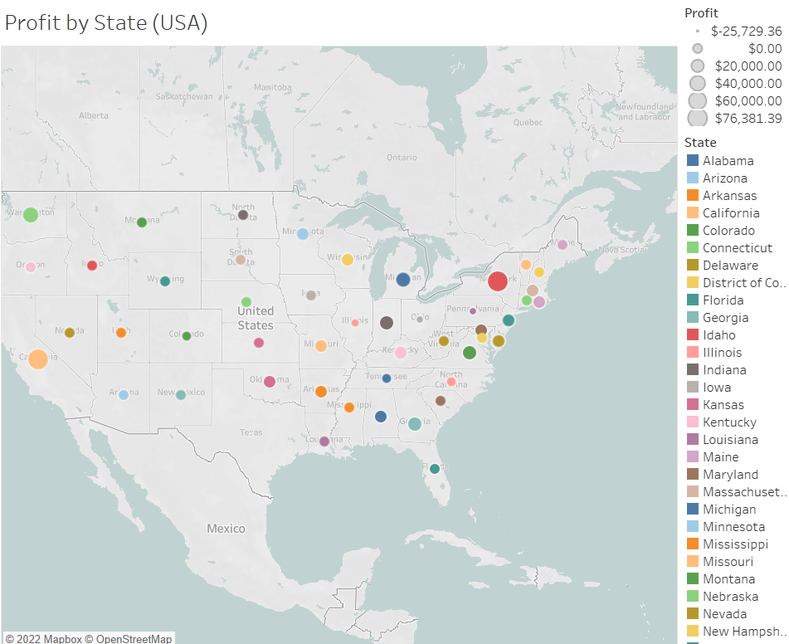
Profile vs Sales (Per State & Segment)

Slide 24
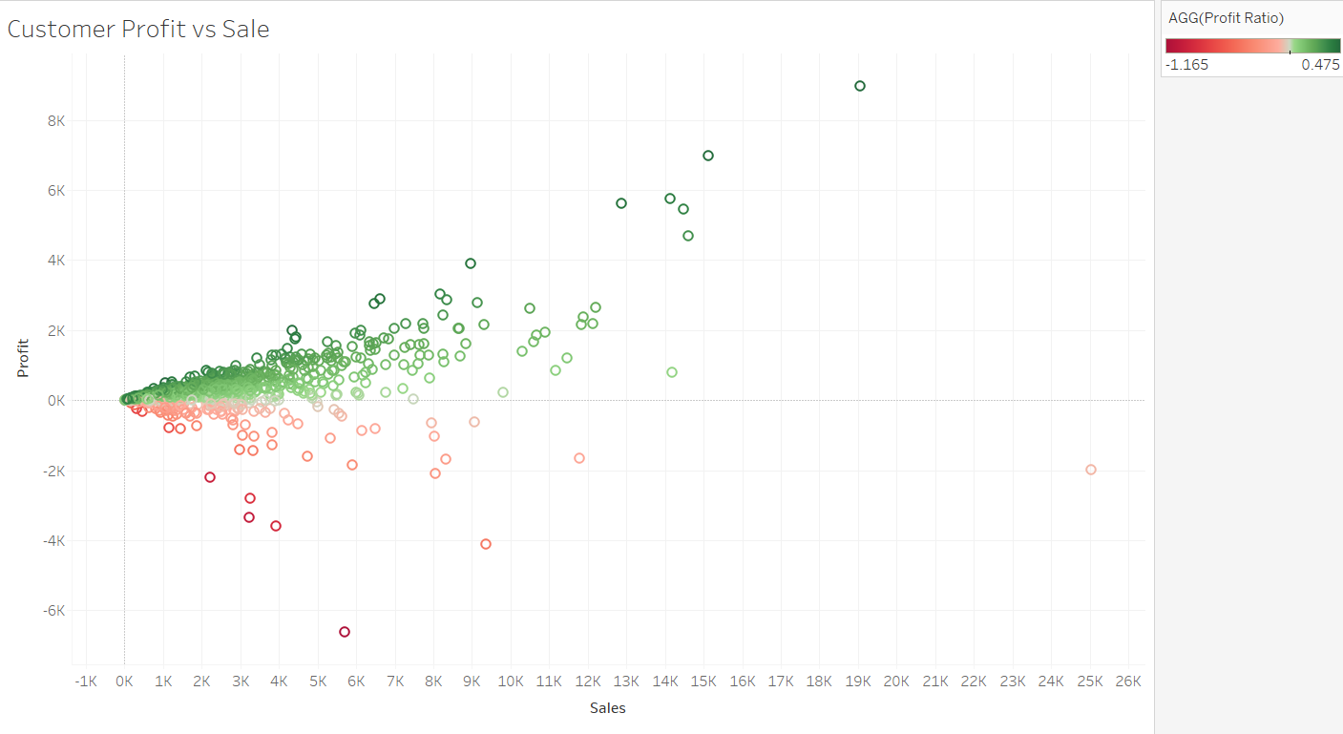
Profit vs Sales

Slide 25
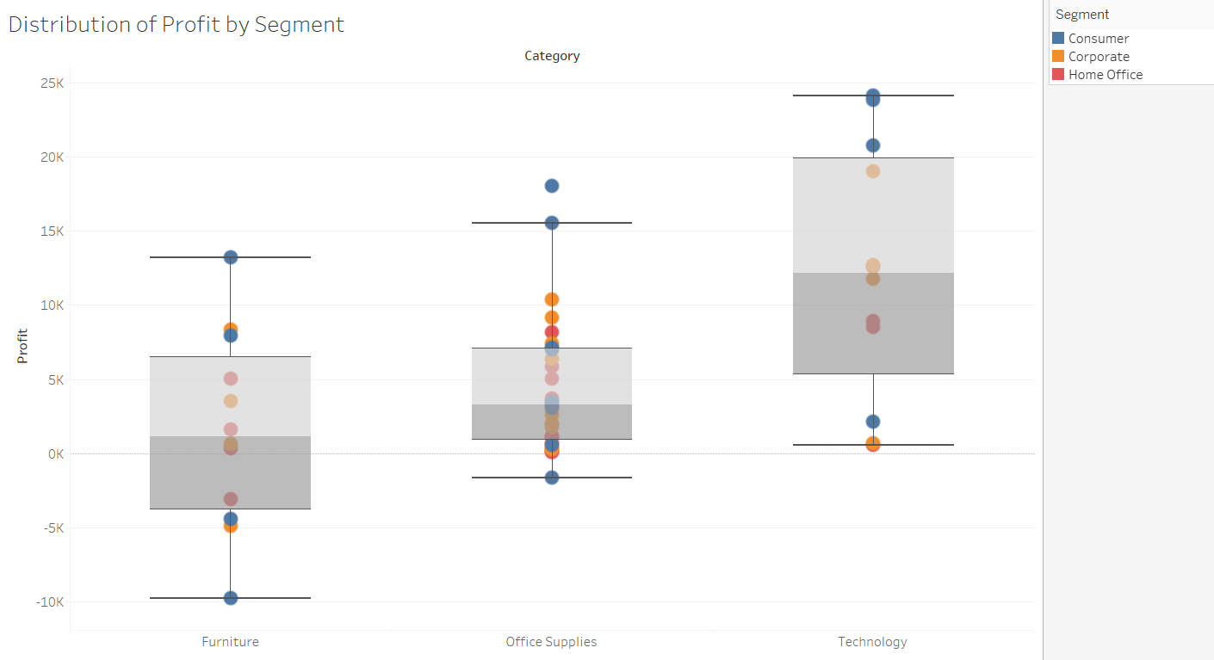
Profile Distribution Per Segment

Slide 26

Sales Dashboard

Slide 27
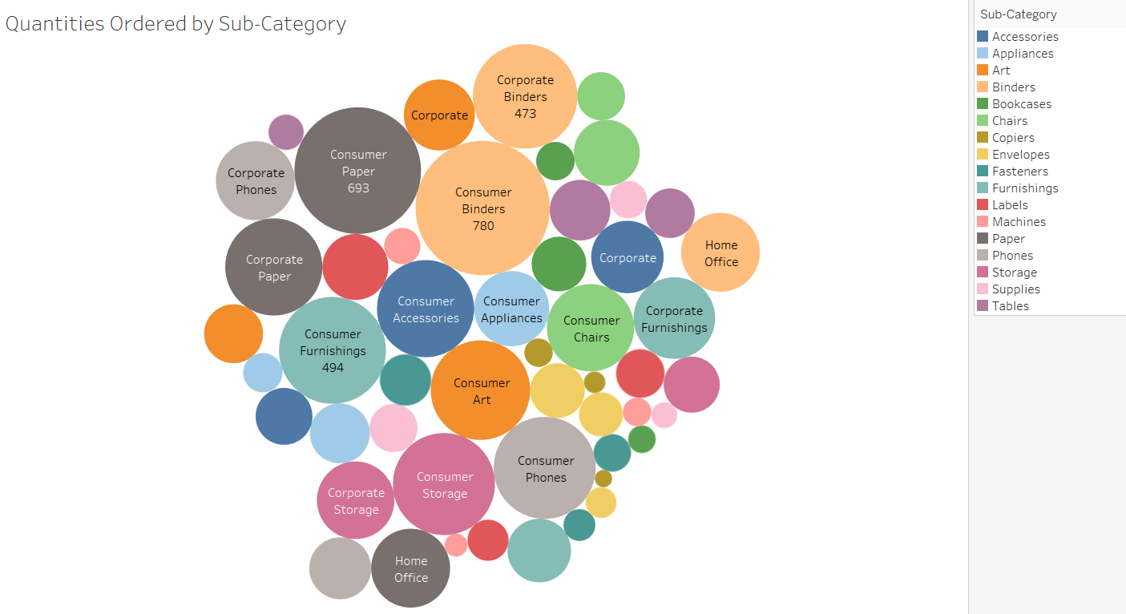
Quantity Distribution

Slide 28
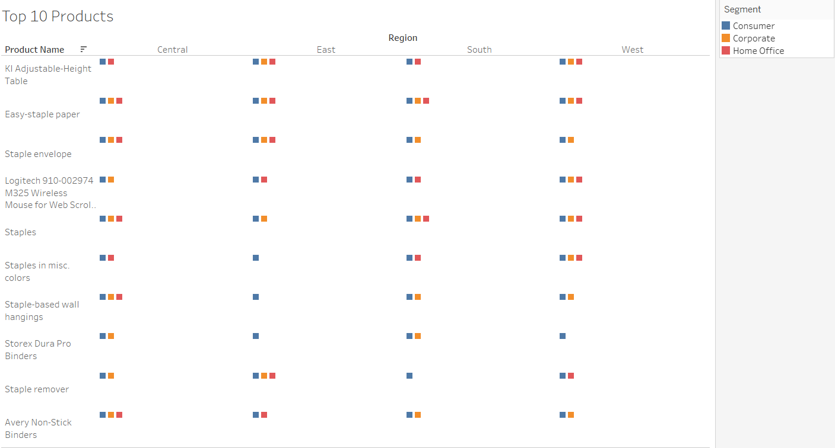
Top Products

Slide 29
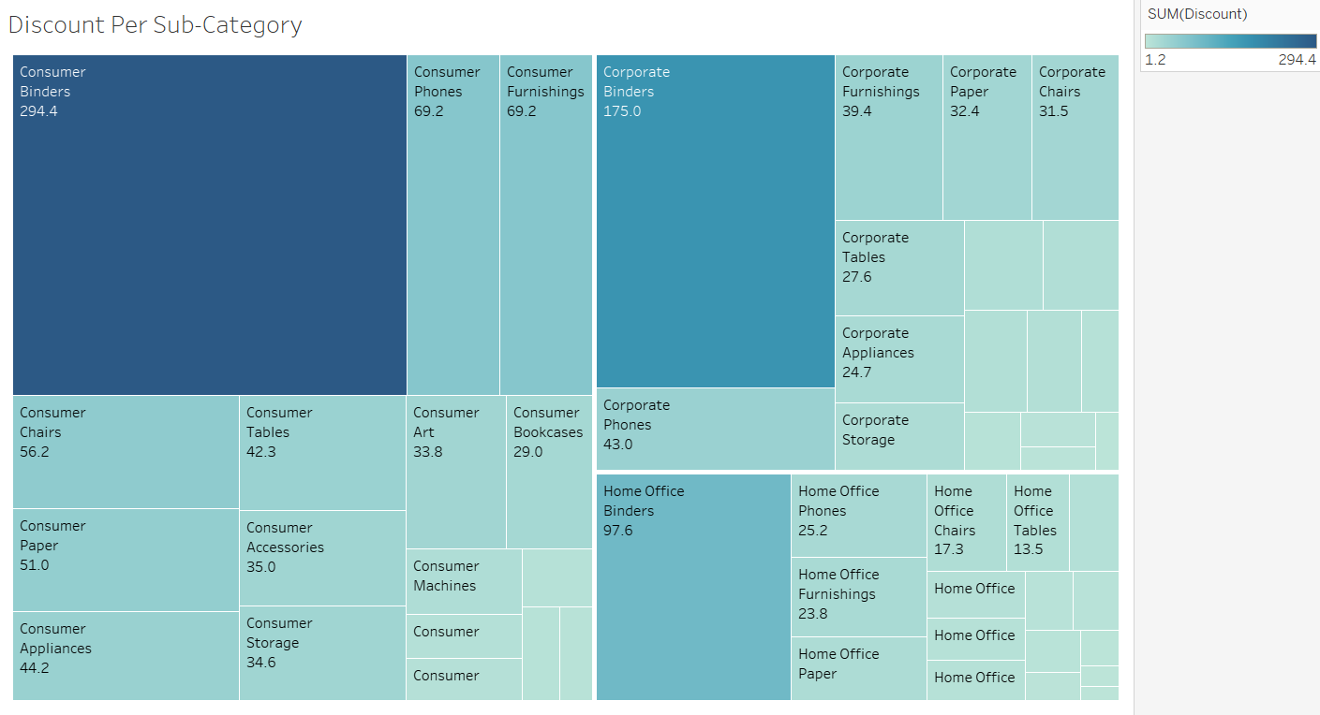

Slide 30

Shipping Dashboard

Slide 31
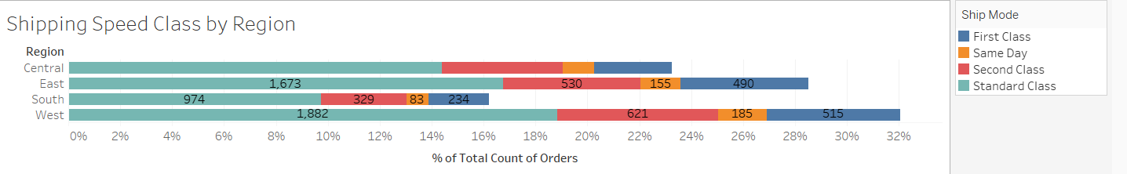
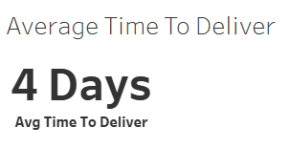
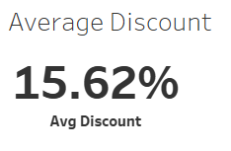
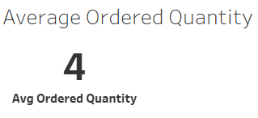
Shipment Distribution

